Slide 1
FRONT END WEB DEVELOPER
Topic: Restaurant project
Submitted by:
Name: KAYALA TEJA
Reg.no: 11810284
Roll.no: 61
Submitted to : Ass. prof. Ruchita Duggal

Slide 2
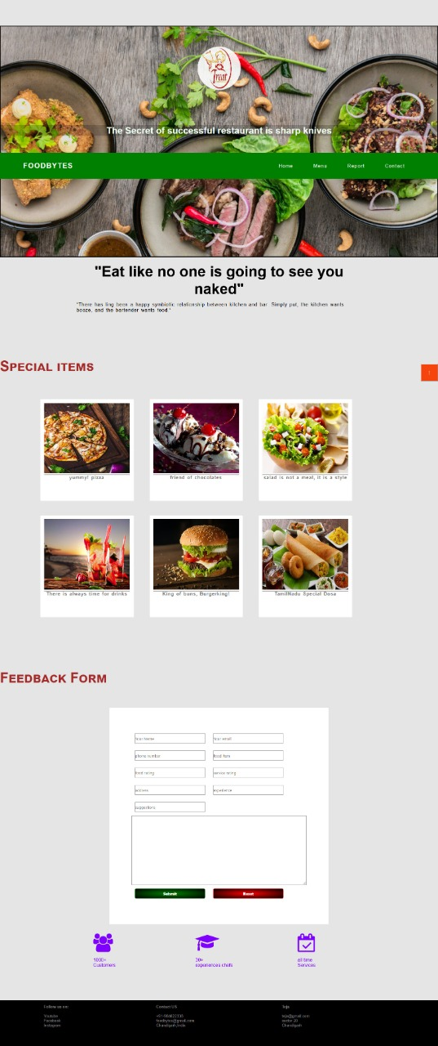
Screen shots of the project:

Slide 3
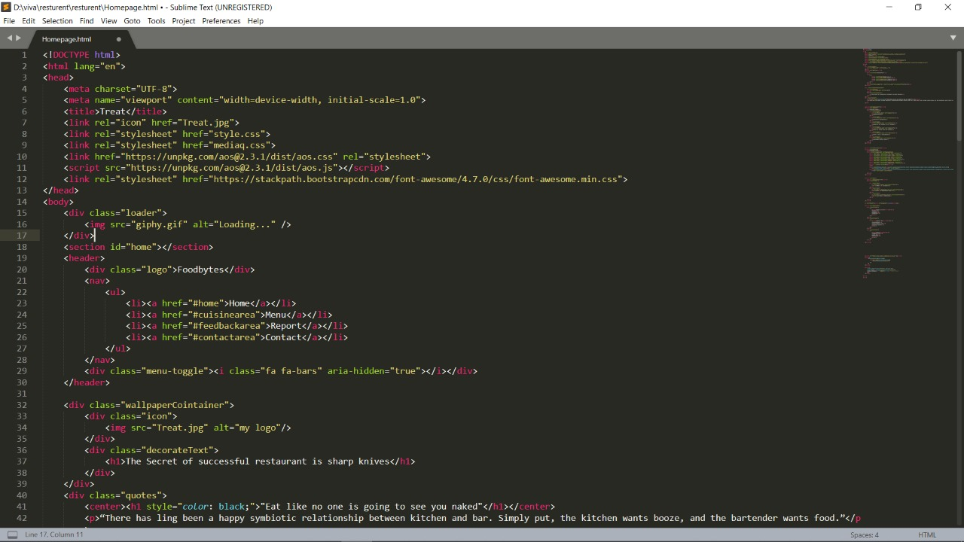

Slide 4
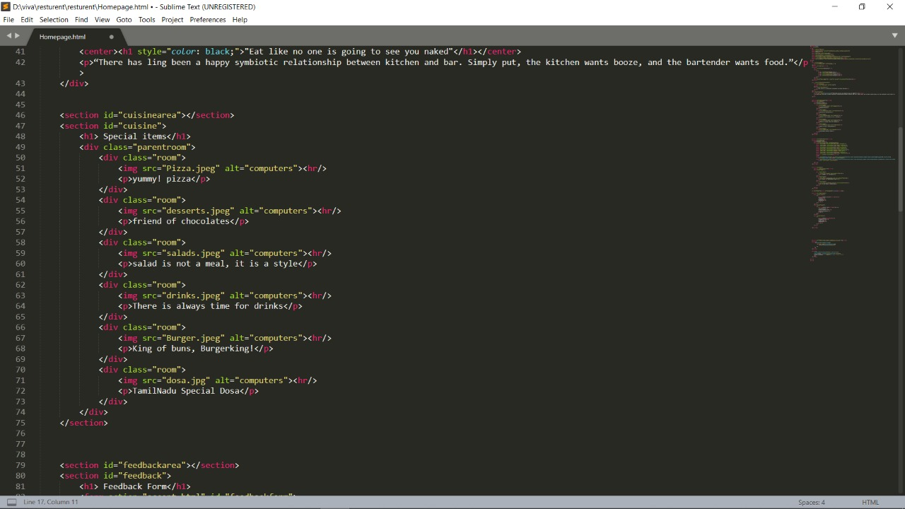

Slide 5
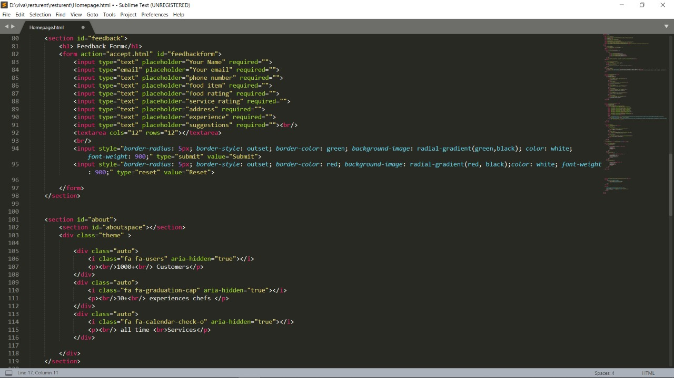

Slide 6
